Slide 1

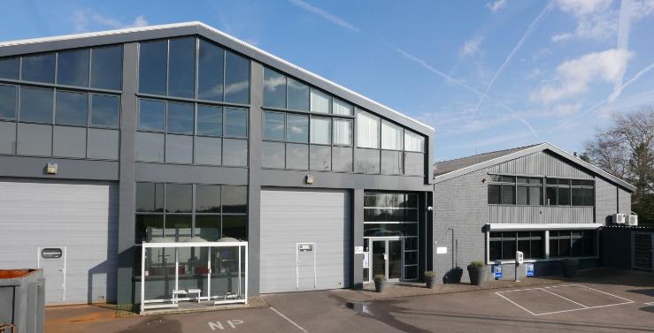
VZ Industries B.V.
Company introduction
Founded in 1959 – started as a one-man workshop
Expanded to the specialized Manufacturer of Steel-based products that we are today
Highly automated production area of 5,000 M2
Flexible and motivated team of technical specialists
ISO 9001 and 14001 certified
Manufacturing in Europe
Markets active:
Automotive
Additive Manufacturing
Copier and Printing
Kiosks
Medical
Cleaning & Hygienic products
Various

Slide 2
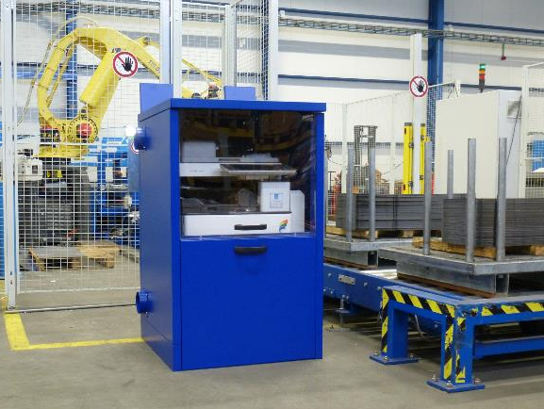
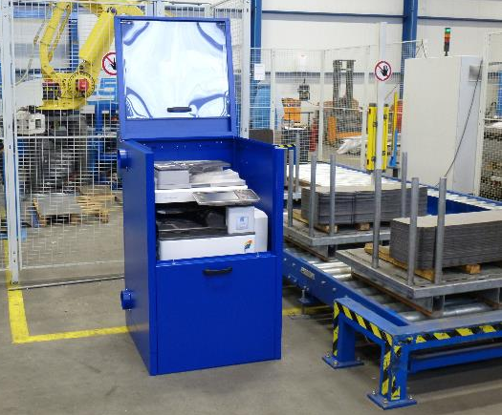
DustCab
History
In 2016 we have produced and tested the first A3 device prototype of the DustCab in our production facility.

Slide 3
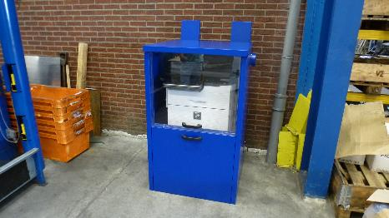
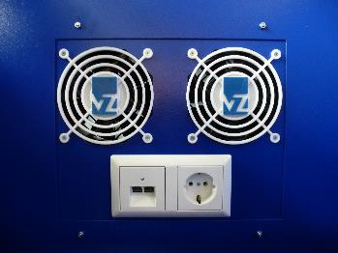
DustCab
History
Since then, the potential in offering a DustCab grew, and in 2018 a Xerox team visited VZ for a demonstration.
Two prototypes of the A3 version were tested in the field by end users for a certain period
The results from the field came back and determined the business requirements for improving the Dustcab(s).

Slide 4
DustCab Business Requirements
Business Problem:
Devices in extremely dirty, dusty or humid environments cause higher downtime & higher operational costs.
Devices in clean room environments require minimal particulate matter and lower emissions.
Business Requirement:
Maintaining business continuity in areas that are environmentally challenging,
Protect devices from outside environment to keep device clean, operable and maintain uptime,
Protect clean room environment by minimizing device emissions into lab or environment,

Slide 5
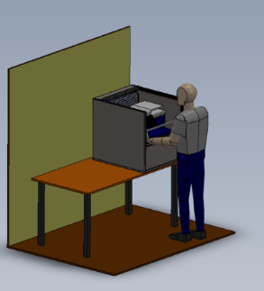
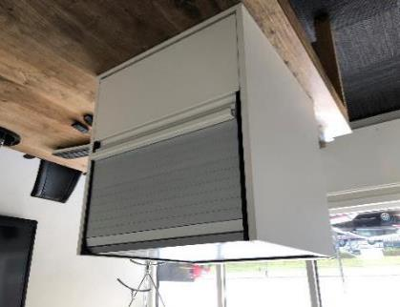
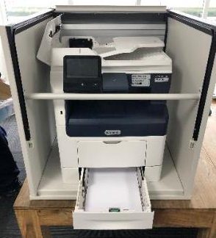
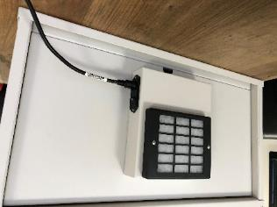
DustCab Business Solution
Development of an ergonomically, self contained ventilation DustCab for use in environmentally sensitive areas
Easy to use and maintain solution designed for A3 and A4 MFP’s
Easy access for supplies & service needs
Ventilation unit can be mounted either internally or externally for internal or external filtration.

Slide 6
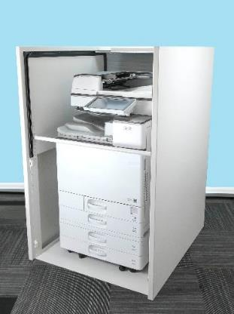
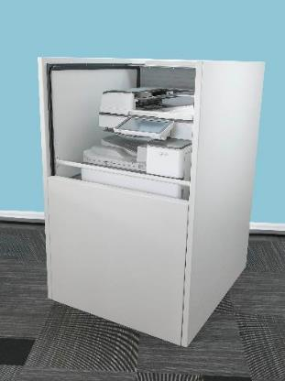
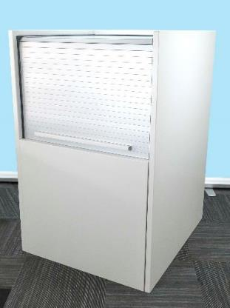
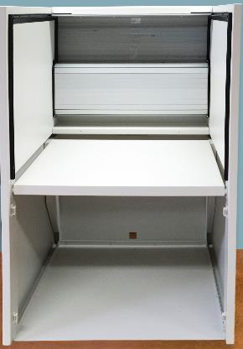
Introducing: The A3 DustCab

Slide 7
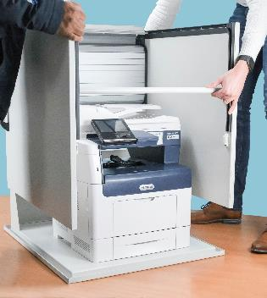
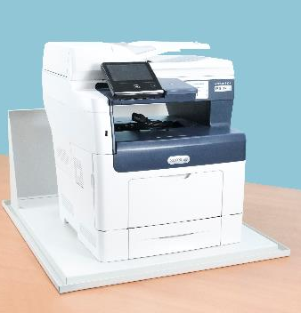
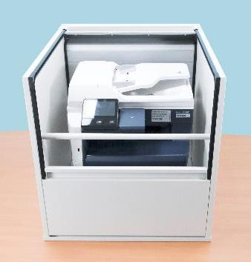
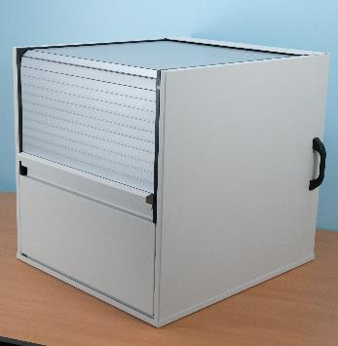
Introducing: The A4 DustCab

Slide 8
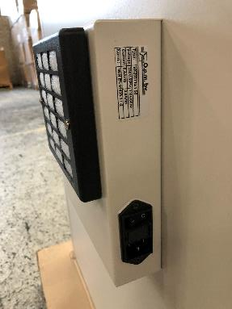
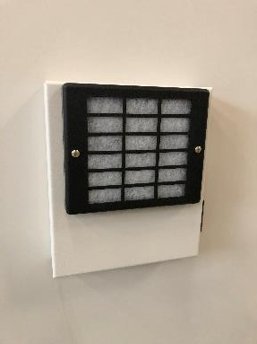
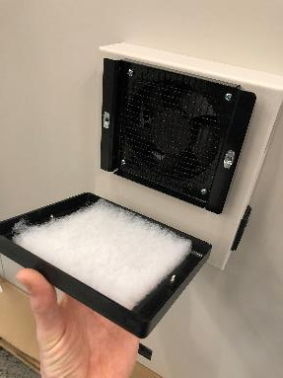
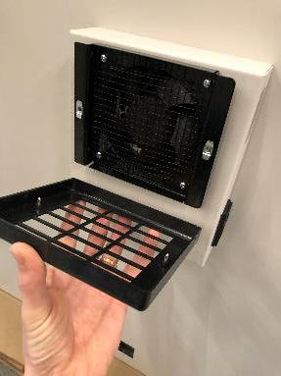
Introducing: The Fan Unit

